Slide 2
CONTENTS
 | PROJECT BACKGROUND | 3
 | PROBLEM STATEMENT | 4
 | SOME BASIC DEFINITION BEFORE WE PROCEED | 5
 | OVERALL APPROACH | 7
 | FIVE SEMANTICS | 8-13
 | CHALLENGES FACED | 14-17
 | OUTPUT | 18
 | FUTURE SCOPE | 19
 | REFERENCE | 20

Slide 3
PROJECT BACKGROUND
Project Background :-
The background of this project is to design and develop an Annotated Relational Algebra System (or ARAS, for short), that implements the work of Green et al [PODS 2007] on provenance semirings.
Project Objective :-
The major objective of this project is to develop annotated calculator which is able to process five different types of semantics .
Apart from the primary objective, the proposed methodology also resolves the following hidden challenges:
Completeness
Soundness
Scalability
Project Application :-
The project is specifically designed and developed for the AI researchers and data miners to integrate and merge large scale data.
Methodology :-
Following tasks were undertaken as a part of completed project :-
Task 1 :- Understanding and Execution of queries in SQL
Task 2 :- Database connectivity and Platform Decision
Task 3 :- Implementation and Testing of the queries on all five semantics
Task 4 :- Improvement of scalability and performance of database engine
Task 5 :- Result and discussion on the obtained outcome

Slide 4






PROBLEM STATEMENT
SEMANTICS
Bag
Probability
Certainty
Provenance
Standard

Slide 5

SOME BASIC DEFINITIONS BEFORE WE PROCEED
Annotations :-
Annotations in general, are statements or comments that provide a better understanding of what is being established or derived.
In terms of relational databases, annotations provide for a base to reason out the provenances that are set to the current or previous data.
Provenance :-
The term provenance refers to the origin or source of a data which may be an output or series of input from other sources.
This is quite important as they provide a mechanism to verify the correctness of the result or data obtained hence, allowing us to verify and check the quality of the data
Tagged Together :-
Together, annotations and provenance form a sort of powerful tool for scholars to clarify the origin of the data and its correctness.
Even security is dealt these days using annotation and propagation rules.
Semirings :-
With the arrival of semirings in graph theory, a lot has been accomplished.
K(+,*,0,1) - Binary Semiring - Commutative and Associative
It is no longer about just ‘retrieving’ the data. Querying has thus evolved into answering questions beyond
Read It carefully might help in finals

Slide 6

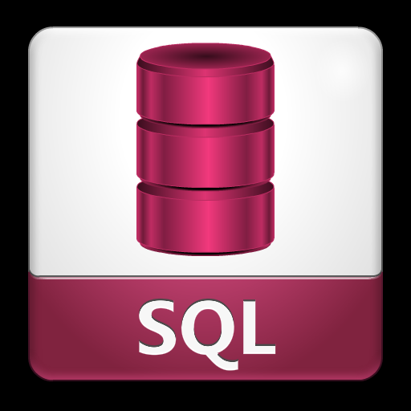


TECHNOLOGY USED
Python
SQL
XAMPP
Primarily used for annotation calculation
To store data points
Used for accessing SQL

Slide 7

OVERALL APPROACH
For Bags, we have randomized digits between 1 to 10
For Provenance, we have appended the character ‘t’.
For Probability, we have assigned a value between 0.0 to 1.0 randomly. (2 Digits)
For Certainty, we have assigned a value between 0.0 to 1.0 randomly.
For Standard Semantics, base model is set as 1.
We have taken the liberty of representing the “UNION” and “PRODUCT” annotations as “+” and “x” respectively

Slide 8
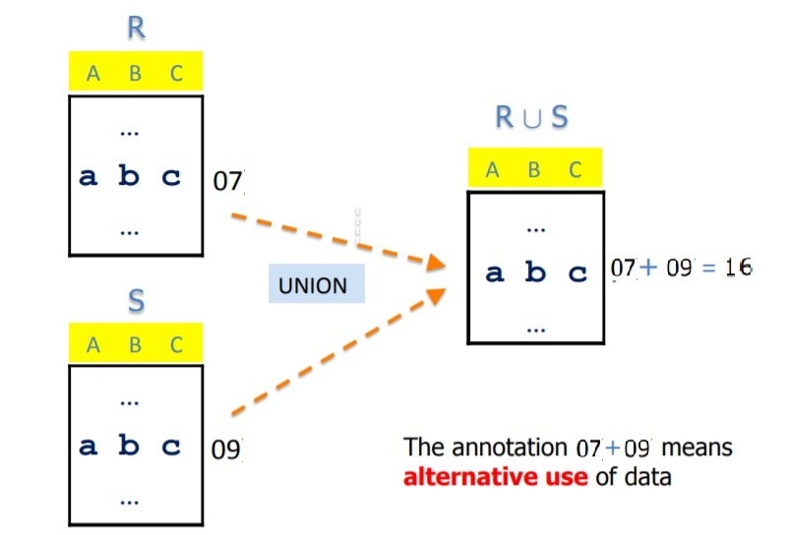
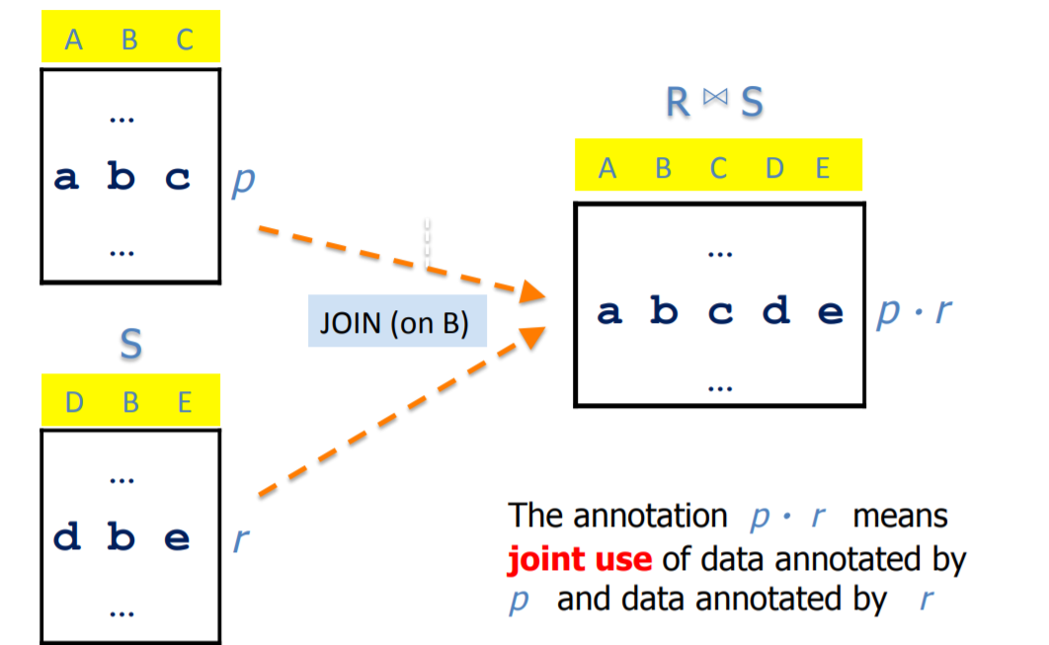
BAG SEMANTICS

Slide 9
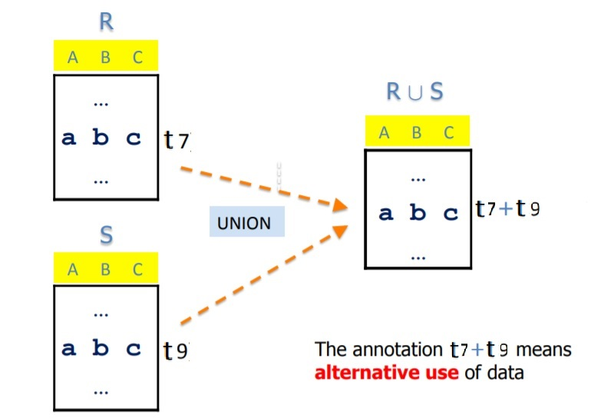
PROVENANCE SEMANTICS

Slide 10
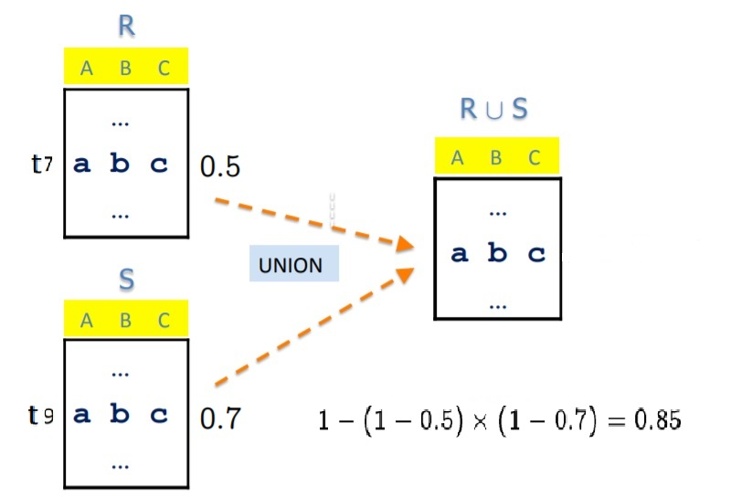
PROBABILITY SEMANTICS

Slide 11
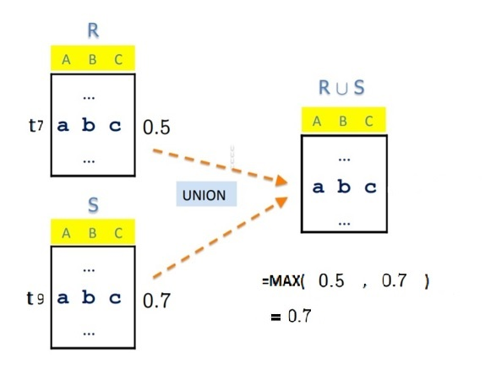
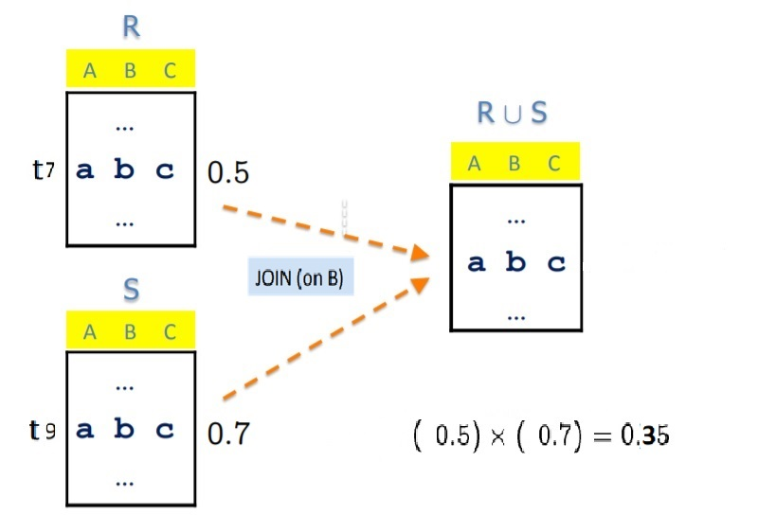
CERTAINTY SEMANTICS

Slide 12
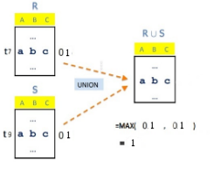
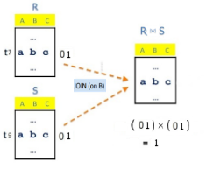
STANDARD PROVENANCE

Slide 13
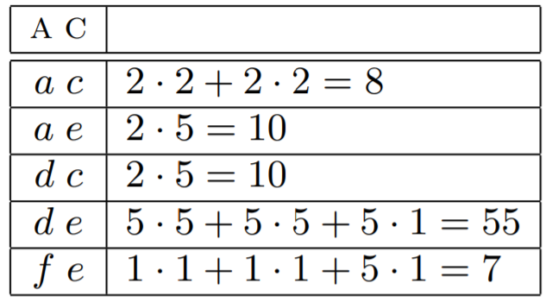
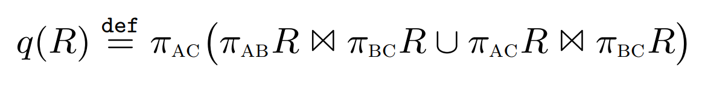
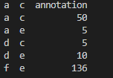
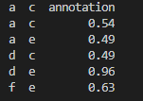
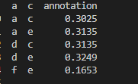
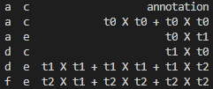
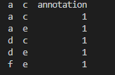
OUTPUT
Query Applied
Bag
Probability
Certainty
Provenance
Standard

Slide 14

CHALLENGES FACED
Prob. 01
Expectation and clarity of Green’s paper
Prob. 03
Prob. 02
Optimization of engine
Calculation of different semantics

Slide 15


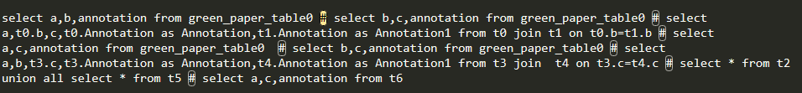
CHALLENGES FACED…….(1)
Embedding Multiple Queries
SQL format

Slide 16



CHALLENGES FACED…….(2)
Annotation Calculation On Multiple Queries
𝝅_{AB} R
𝝅_{BC} R
𝝅_{AC} R
𝝅_{BC} R
𝝅_{AC} Resullt

Slide 17

CHALLENGES FACED…….(3)
Bulk Insertion Of Records
4600 records(5 tables) - more than 15 mins
4600 records(5 tables) - 16 seconds

Slide 18

DEMO

Slide 19
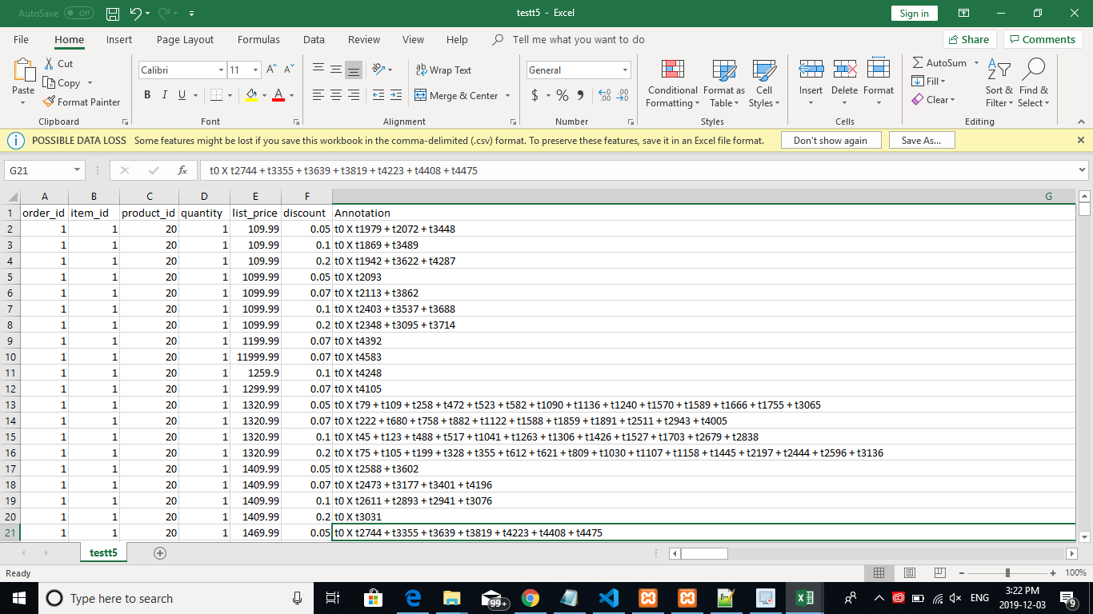
DEMO

Slide 20
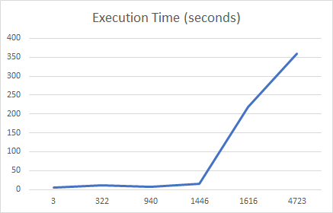
RESULTS
Annotation Calculation On Multiple Queries
Record Size | Tuples Generated | Execution time(sec)
3 | 5 | 5
322 | 12133 | 12
940 | 901 | 7
1446 | 14298 | 16
1616 | 473986 | 188
4723 | >1000000 | <260

Slide 21
CONCLUSION AND FUTURE WORK
We have successfully built a system that automates all the algebraic annotated propagation.
Although currently, it supports only attributes of tuples.
Conclusion
The future extension that we would like to work on is the ability to support hierarchical data (XML).
The current UNION functionality doesn't support negation. This can be a part of the future work.
Performance and storage specs can be investigated on other platforms and architecture.
A complete end-to-end and refined framework that provides sufficient annotated reasoning can be worked on
Future Work

Slide 22

REFERENCES
[1] http://www.vldb.org/conf/2004/RS23P1.PDF
[2] https://wiki.epfl.ch/provenance2011/documents/provenance-seminar.pdf
[3] https://www.cis.upenn.edu/~val/EDBTkeynoteLausanne.pdf
[4] https://users.encs.concordia.ca/~c65912/notes/Readings/greenS.pdf
[5] http://sites.computer.org/debull/A07dec/wang-chiew.pdf
[6] https://users.encs.concordia.ca/~c65912/notes/Readings/AR2000.pdf
[7] https://users.encs.concordia.ca/~c65912/notes/Readings/K-Relations.pdf
[8]https://courses.cs.washington.edu/courses/cse544/11wi/projects/hornyack_hunt.pdf

Slide 23
THANK YOU

